Slide 1
Azure Kubernetes Service
Cloud Team
2021.07.14

Slide 2
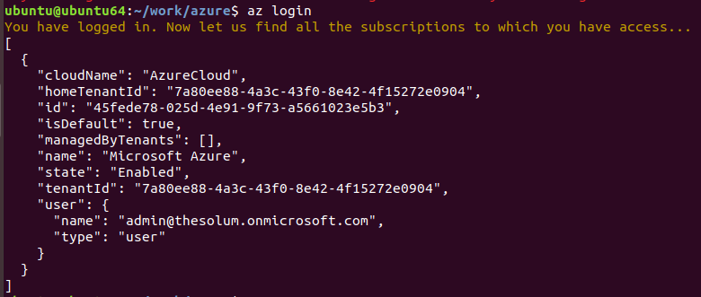
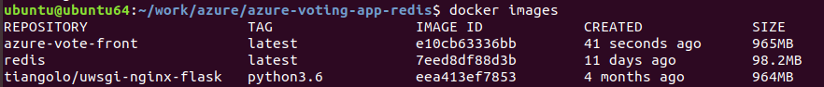
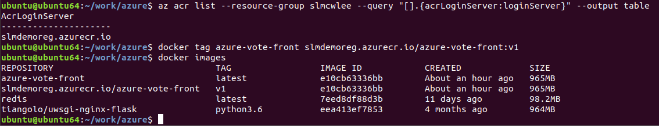
Docker
1

Slide 3
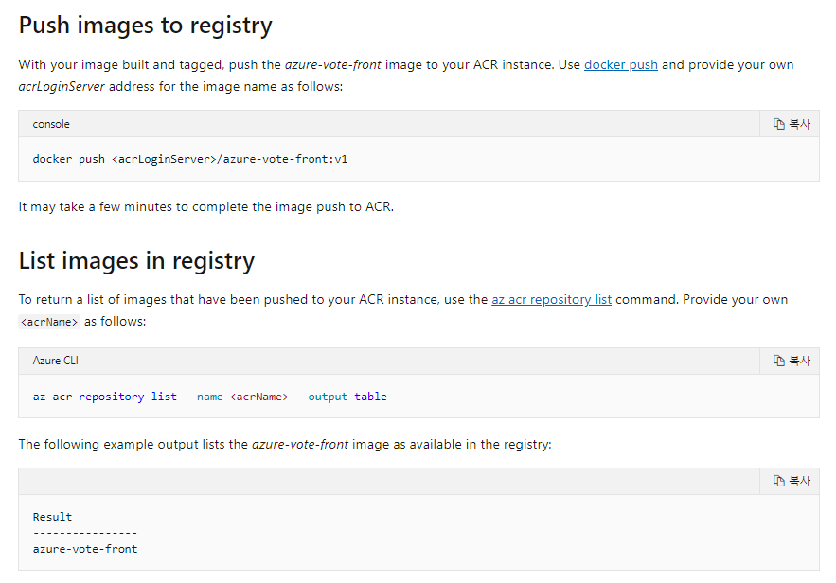
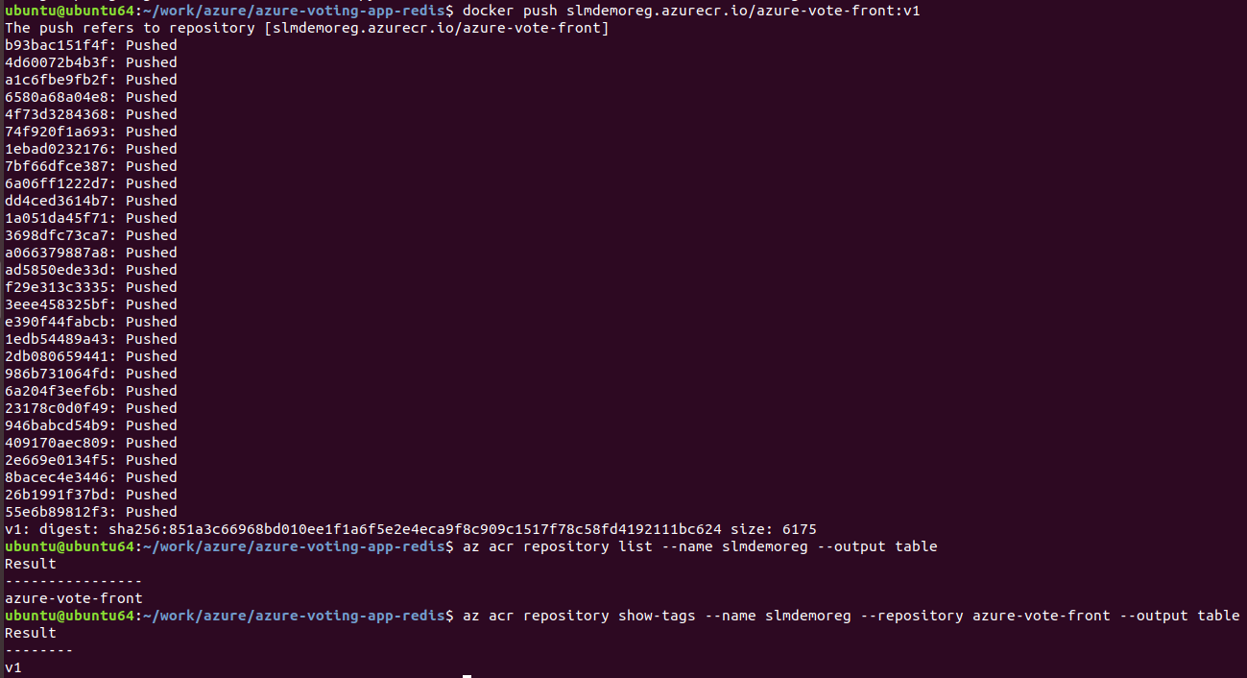
Docker
1

Slide 4
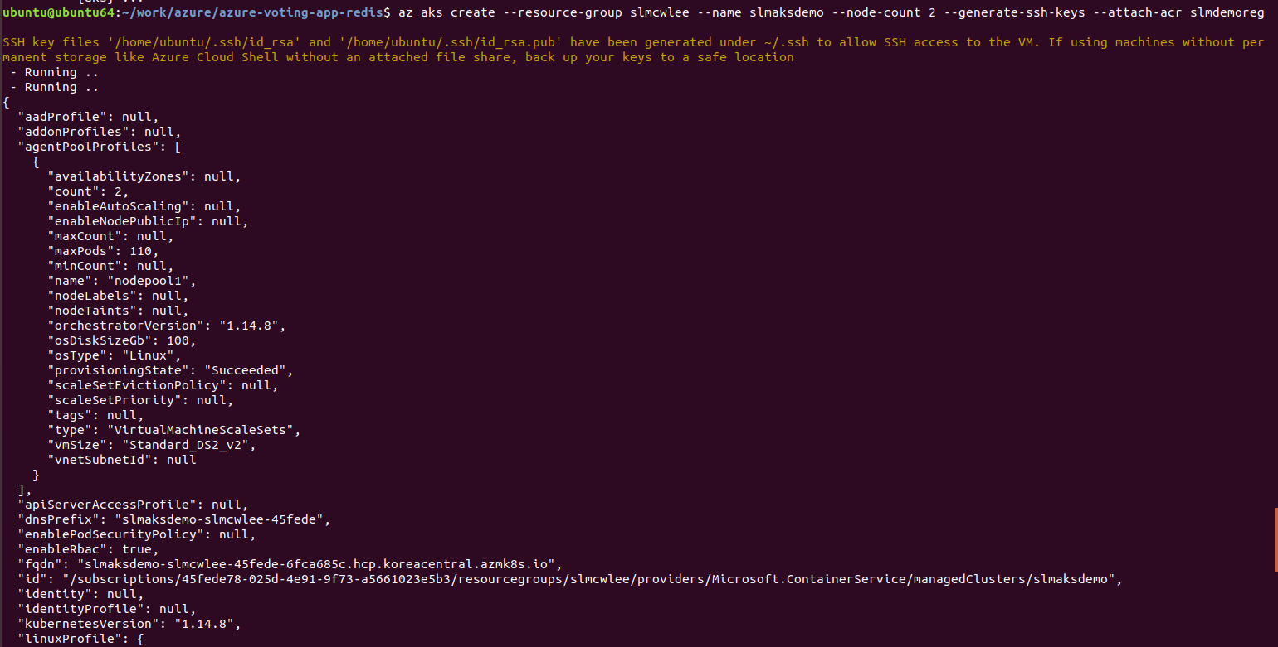
Docker
ACR – Azure Container Registry

Slide 5
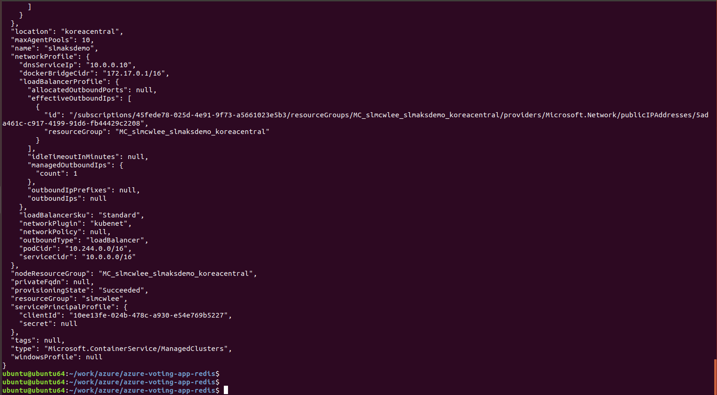
Docker
1

Slide 6
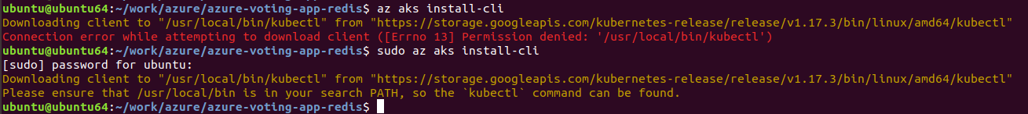
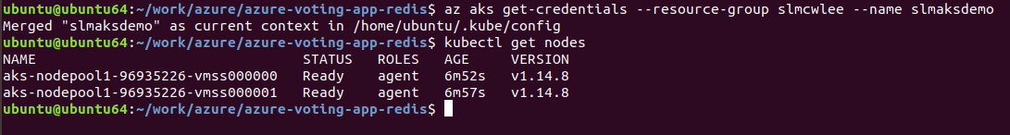
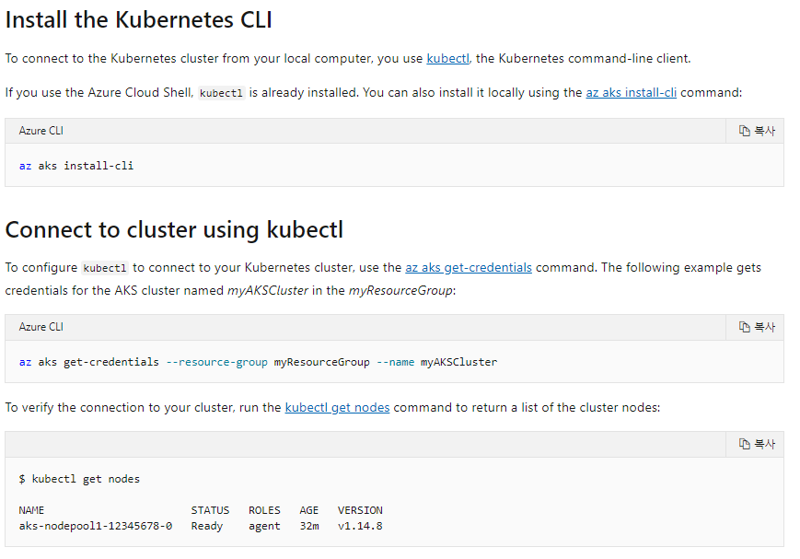
Docker
1

Slide 7
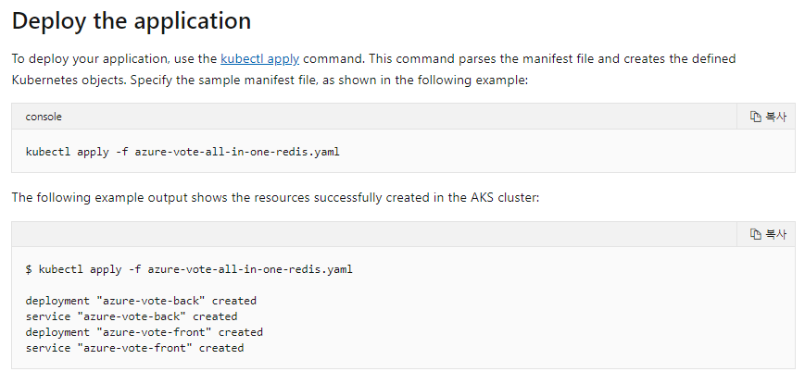
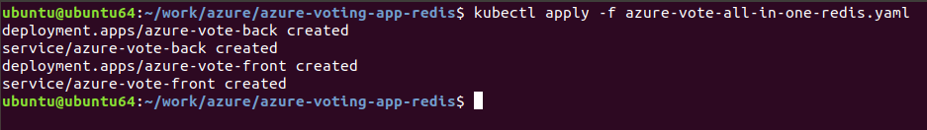
Docker
1

Slide 8
Docker
resource - slmcwlee
aks - slmaksdemo
acr - slmdemoreg
cluster - slmaskcluster

Slide 9
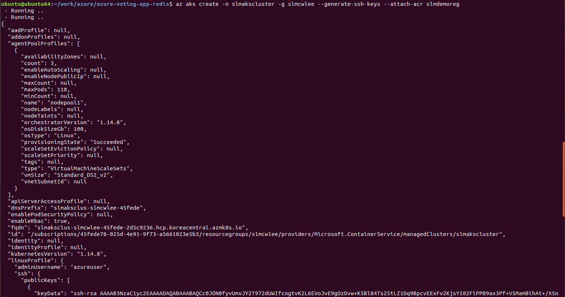
Docker
# Create an AKS cluster with ACR integration

Slide 10
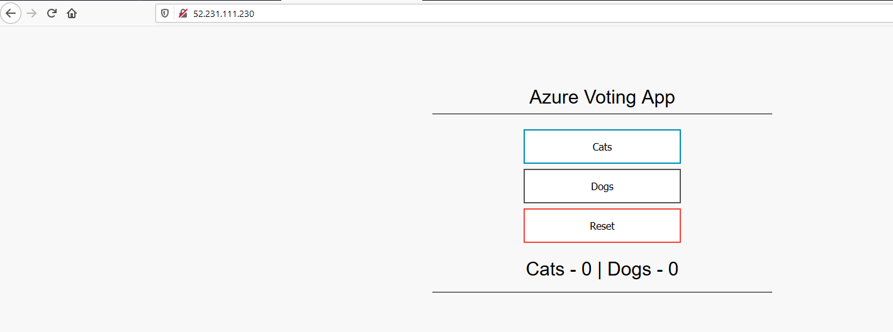
Docker
1

Slide 11
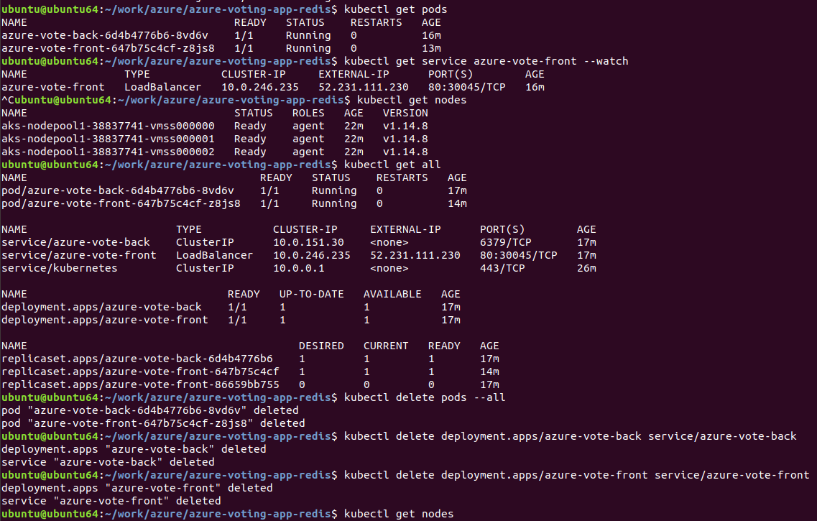
Docker
1

Slide 12
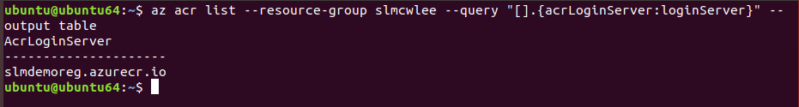
Docker
az acr list --resource-group slmcwlee --query "[].{acrLoginServer:loginServer}" --output table

Slide 13
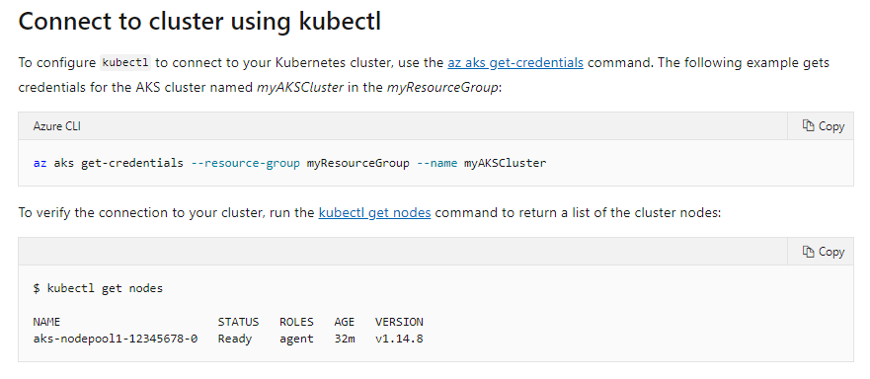
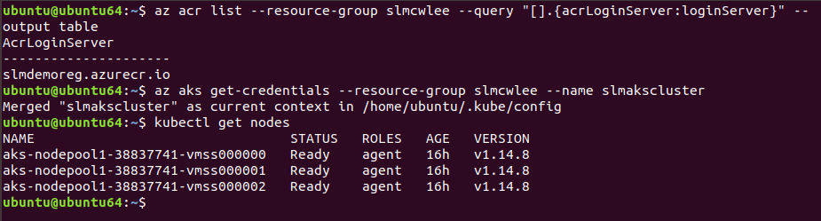
Docker
az aks get-credentials --resource-group slmcwlee --name slmakscluster

Slide 14
YML
spec:
replicas: 1
strategy:
rollingUpdate:
maxSurge: 1
maxUnavailable: 1
minReadySeconds: 5
template:
metadata:
labels:
app: azure-vote-front
spec:
nodeSelector:
"beta.kubernetes.io/os": linux
containers:
- name: azure-vote-front
image: slmdemoreg.azurecr.io/azure-vote-front:v1
ports:
- containerPort: 80
resources:
requests:
cpu: 250m
limits:
cpu: 500m
env:
- name: REDIS
value: "azure-vote-back"

Slide 15
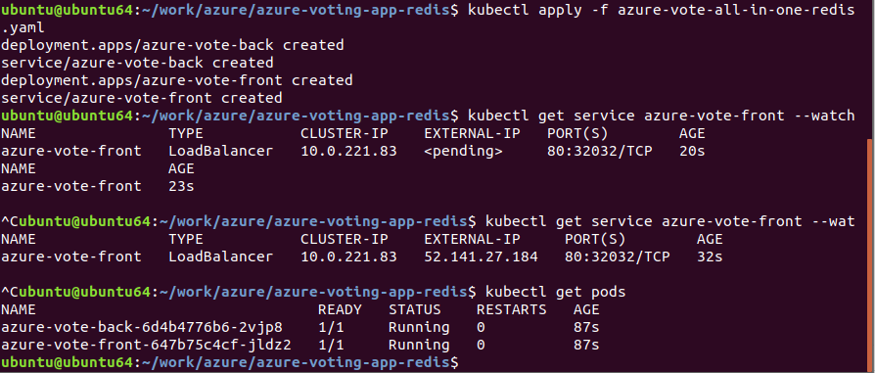
Docker
kubectl apply -f azure-vote-all-in-one-redis.yaml
kubectl get service azure-vote-front --watch

Slide 16
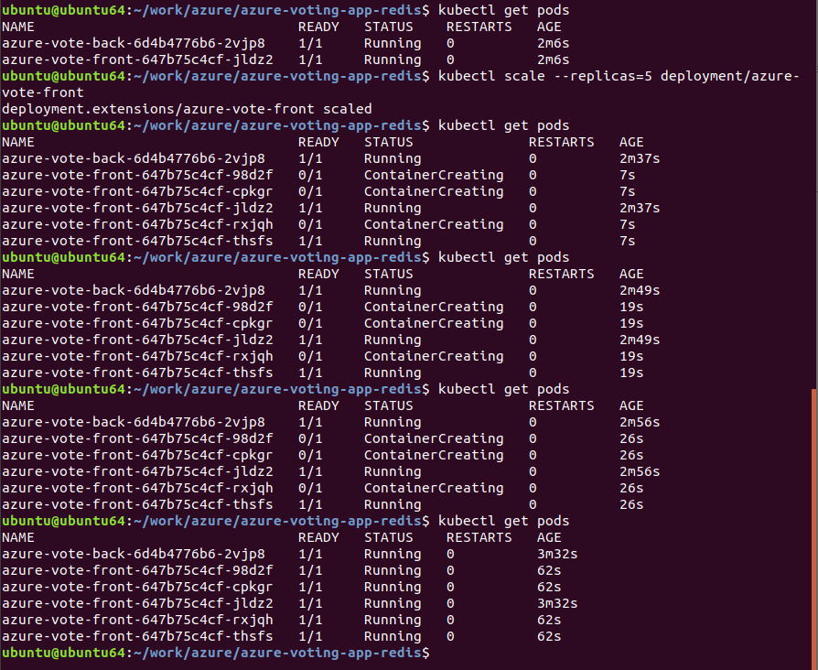
Scaling out manually
kubectl scale --replicas=5 deployment/azure-vote-front

Slide 17
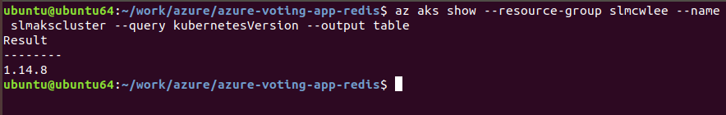
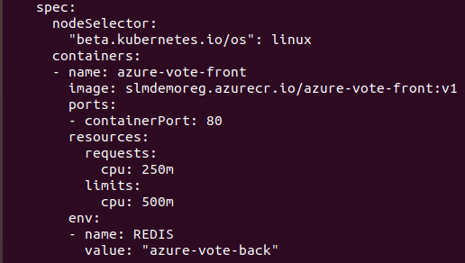
Docker
Autoscale pods
Kubernetes supports horizontal pod autoscaling to adjust the number of pods in a deployment depending on CPU utilization or other select metrics. The Metrics Server is used to provide resource utilization to Kubernetes, and is automatically deployed in AKS clusters versions 1.10 and higher. To see the version of your AKS cluster, use the az aks show command, as shown in the following example:
az aks show --resource-group slmcwlee --name slmakscluster --query kubernetesVersion --output table

Slide 18
Monitoring
-------------AKS Cluster------------
---connect to AKS Cluster
az aks get-credentials --resource-group rg-hgdev-191128 --name Kubernetes-poc
---Check if you have connected to AKS cluster or not
kubectl get nodes
kubectl get nodes -o wide
-------start service yaml based config--------
kubectl apply -f azure-vote.yaml
------------status----------
kubectl get service azure-vote-front --watch
kubectl get all
--------stop all sevices--------
kubectl delete pods --all
kubectl delete deployment.apps/azure-vote-back service/azure-vote-back
kubectl delete deployment.apps/azure-vote-front service/azure-vote-front

Slide 19
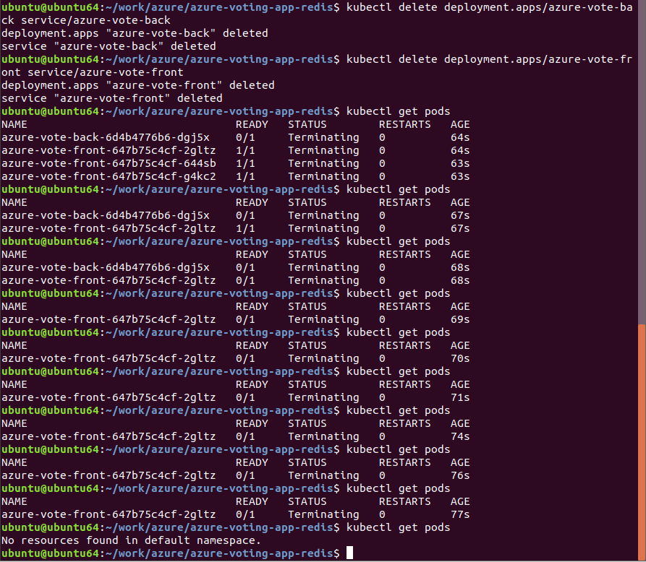
Docker (Horizontal pod scaler – HPA)
Canceling autoscaling
kubectl delete hpa name-of-hpa
ex) kubectl delete hpa azure-vote-front
kubectl delete pods --all
kubectl delete deployment.apps/azure-vote-back service/azure-vote-back
kubectl delete deployment.apps/azure-vote-front service/azure-vote-front

Slide 20
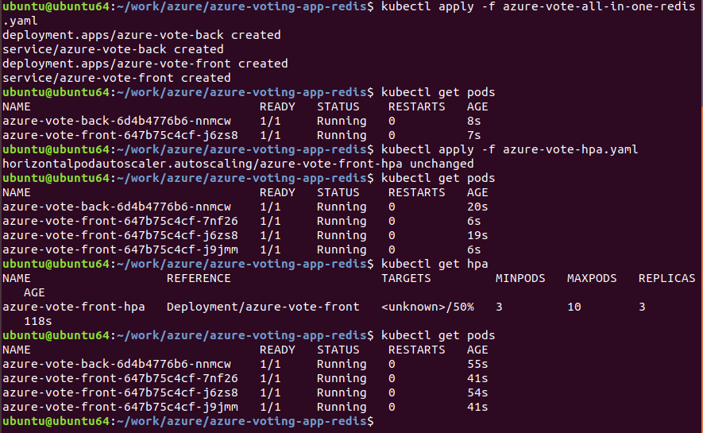
Docker
1

Slide 21
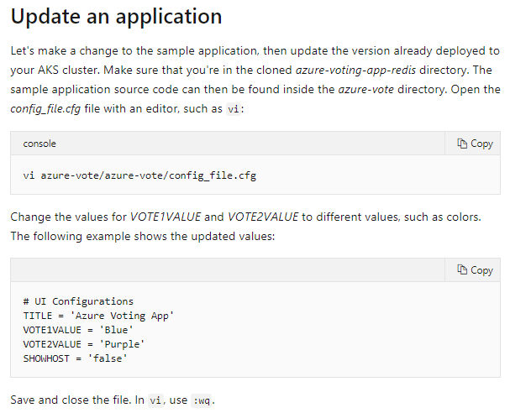
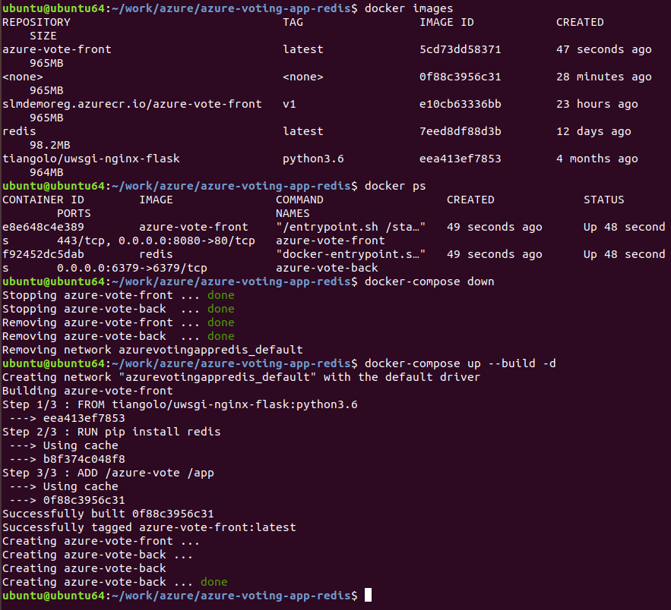
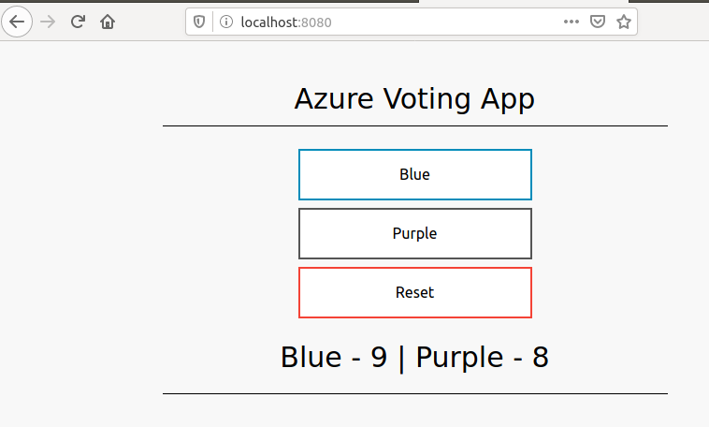
Updating a configuration file
1

Slide 22
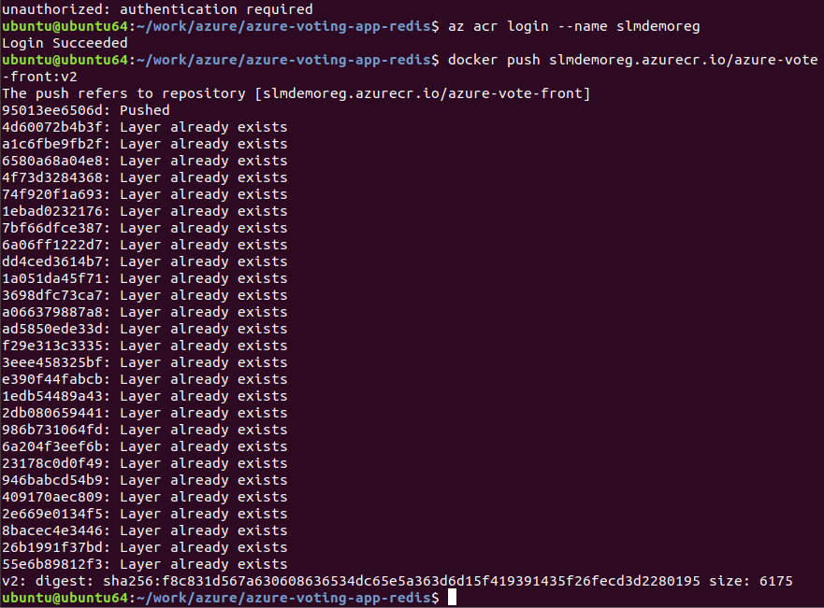
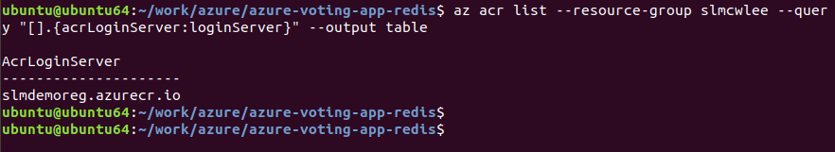
Docker
az acr list --resource-group myResourceGroup --query "[].{acrLoginServer:loginServer}" --output table
az acr list --resource-group slmcwlee --query "[].{acrLoginServer:loginServer}" --output table
docker tag azure-vote-front <acrLoginServer>/azure-vote-front:v2
docker tag azure-vote-front slmdemoreg.azurecr.io/azure-vote-front:v2
docker push <acrLoginServer>/azure-vote-front:v2
docker push slmdemoreg.azurecr.io/azure-vote-front:v2

Slide 23
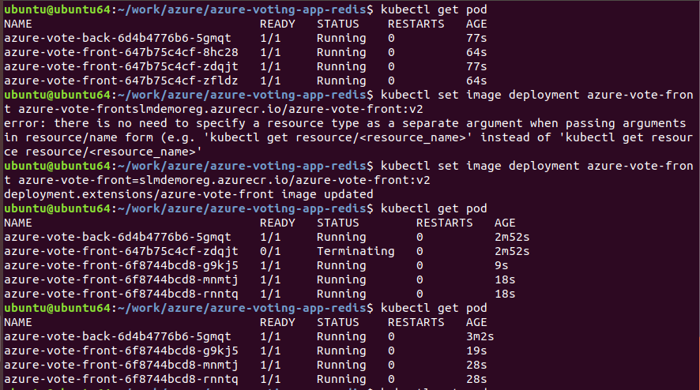
Docker
kubectl set image deployment azure-vote-front azure-vote-front=<acrLoginServer>/azure-vote-front:v2
kubectl set image deployment azure-vote-front azure-vote-front=slmdemoreg.azurecr.io/azure-vote-front:v2
kubectl get service azure-vote-front

Slide 24
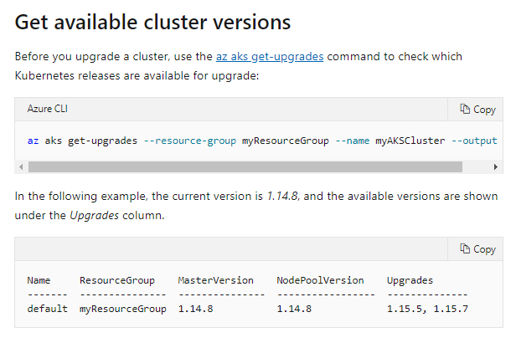
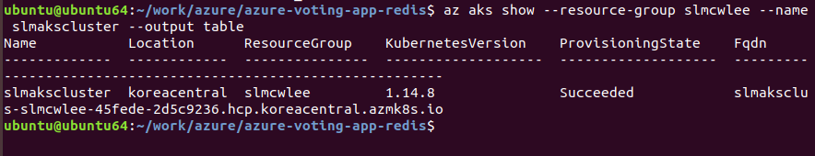
Docker
az aks get-upgrades --resource-group myResourceGroup --name myAKSCluster --output table
az aks get-upgrades --resource-group slmcwlee --name slmakscluster --output table
az aks show --resource-group slmcwlee --name slmakscluster --output table

Slide 25
Deleting the cluster
az group delete --name myResourceGroup --yes --no-wait
az group delete --name slmcwlee --yes --no-wait

Slide 26
Microsoft Azure AKS

Slide 27
Creating AKS Cluster
https://shell.azure.com/
kimsuni@Azure:~$ az group create --name cwleeDevOpsGroup --location koreacentral
{
"id": "/subscriptions/c936f1e5-4e72-4aa7-88c4-a38d2925139a/resourceGroups/cwleeDevOpsGroup",
"location": "koreacentral",
"managedBy": null,
"name": "cwleeDevOpsGroup",
"properties": {
"provisioningState": "Succeeded"
},
"tags": null,
"type": "Microsoft.Resources/resourceGroups"
}

Slide 28
Testing on Ubuntu (az login)
ubuntu@ubuntu64:~$ az login
You have logged in. Now let us find all the subscriptions to which you have access...
[
{
"cloudName": "AzureCloud",
"homeTenantId": "7a80ee88-4a3c-43f0-8e42-4f15272e0904",
"id": "45fede78-025d-4e91-9f73-a5661023e5b3",
"isDefault": true,
"managedByTenants": [],
"name": "Microsoft Azure",
"state": "Enabled",
"tenantId": "7a80ee88-4a3c-43f0-8e42-4f15272e0904",
"user": {
"name": "admin@thesolum.onmicrosoft.com",
"type": "user"
}
}
]
ubuntu@ubuntu64:~$

Slide 29
Creating Resource Group
ubuntu@ubuntu64:~$ az group create --name cwDevOpsGroup --location koreacentral
{
"id": "/subscriptions/45fede78-025d-4e91-9f73-a5661023e5b3/resourceGroups/cwDevOpsGroup",
"location": "koreacentral",
"managedBy": null,
"name": "cwDevOpsGroup",
"properties": {
"provisioningState": "Succeeded"
},
"tags": null,
"type": "Microsoft.Resources/resourceGroups"
}

Slide 30
Creating AKS Cluster
ubuntu@ubuntu64:~$ az aks create -g cwDevOpsGroup --name cwAKSCluster --generate-ssh-keys
{
"aadProfile": null,
"addonProfiles": null,
"agentPoolProfiles": [
{
"availabilityZones": null,
"count": 3,
"enableAutoScaling": null,
"enableNodePublicIp": null,
"maxCount": null,
"maxPods": 110,
"minCount": null,
"name": "nodepool1",
"nodeLabels": null,
"nodeTaints": null,
"orchestratorVersion": "1.15.10",
"osDiskSizeGb": 100,
"osType": "Linux",
"provisioningState": "Succeeded",
"scaleSetEvictionPolicy": null,
"scaleSetPriority": null,
"tags": null,
"type": "VirtualMachineScaleSets",
"vmSize": "Standard_DS2_v2",
"vnetSubnetId": null
}
],

Slide 31
Download AKS Credential
ubuntu@ubuntu64:~$ az aks get-credentials --resource-group cwDevOpsGroup --name cwAKSCluster
Merged "cwAKSCluster" as current context in /home/ubuntu/.kube/config
ubuntu@ubuntu64:~$
Reource Group : cwDevOpsGroup
AKS Cluster : cwAKSCluster
az group create --name cwDevOpsGroup --location koreacentral
az aks create -g cwDevOpsGroup --name cwAKSCluster --generate-ssh-keys
az aks get-credentials --resource-group cwDevOpsGroup --name cwAKSCluster

Slide 32
checking which services are on running.
# kubectl get all
ubuntu@ubuntu64:~$ kubectl get all
NAME TYPE CLUSTER-IP EXTERNAL-IP PORT(S) AGE
service/kubernetes ClusterIP 10.0.0.1 <none> 443/TCP 12m
ubuntu@ubuntu64:~$

Slide 33
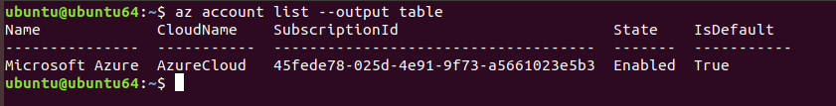
Checking account (by using az)
ubuntu@ubuntu64:~$ az login
You have logged in. Now let us find all the subscriptions to which you have access...
[
{
"cloudName": "AzureCloud",
"homeTenantId": "7a80ee88-4a3c-43f0-8e42-4f15272e0904",
"id": "45fede78-025d-4e91-9f73-a5661023e5b3",
"isDefault": true,
"managedByTenants": [],
"name": "Microsoft Azure",
"state": "Enabled",
"tenantId": "7a80ee88-4a3c-43f0-8e42-4f15272e0904",
"user": {
"name": "admin@thesolum.onmicrosoft.com",
"type": "user"
}
}
]
ubuntu@ubuntu64:~$ clear
ubuntu@ubuntu64:~$ az account list --output table
Name CloudName SubscriptionId State IsDefault
--------------- ----------- ------------------------------------ ------- -----------
Microsoft Azure AzureCloud 45fede78-025d-4e91-9f73-a5661023e5b3 Enabled True

Slide 34
Commands
ubuntu@ubuntu64:~$ kubectl get pods
No resources found in default namespace.
ubuntu@ubuntu64:~$ kubectl get nodes
NAME STATUS ROLES AGE VERSION
aks-nodepool1-14840076-vmss000000 Ready agent 14h v1.15.10
aks-nodepool1-14840076-vmss000001 Ready agent 14h v1.15.10
aks-nodepool1-14840076-vmss000002 Ready agent 14h v1.15.10
ubuntu@ubuntu64:~$ kubectl get nodes -o wide
NAME STATUS ROLES AGE VERSION INTERNAL-IP EXTERNAL-IP OS-IMAGE KERNEL-VERSION CONTAINER-RUNTIME
aks-nodepool1-14840076-vmss000000 Ready agent 14h v1.15.10 10.240.0.4 <none> Ubuntu 16.04.6 LTS 4.15.0-1071-azure docker://3.0.10+azure
aks-nodepool1-14840076-vmss000001 Ready agent 14h v1.15.10 10.240.0.5 <none> Ubuntu 16.04.6 LTS 4.15.0-1071-azure docker://3.0.10+azure
aks-nodepool1-14840076-vmss000002 Ready agent 14h v1.15.10 10.240.0.6 <none> Ubuntu 16.04.6 LTS 4.15.0-1071-azure docker://3.0.10+azure
ubuntu@ubuntu64:~$ kubectl get all
NAME TYPE CLUSTER-IP EXTERNAL-IP PORT(S) AGE
service/kubernetes ClusterIP 10.0.0.1 <none> 443/TCP 14h
ubuntu@ubuntu64:~$

Slide 35
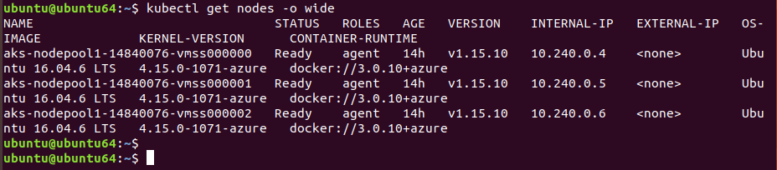
K8S (Presently, there is no pod)
You can check the status K8S periodically by using linux watch command as below
watch kubectl get all
watch kubectl get pods
watch kubectl get nodes
kubectl get nodes -o wide

Slide 36
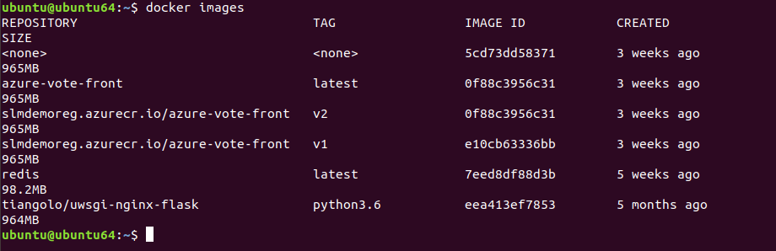
Test
docker images

Slide 37
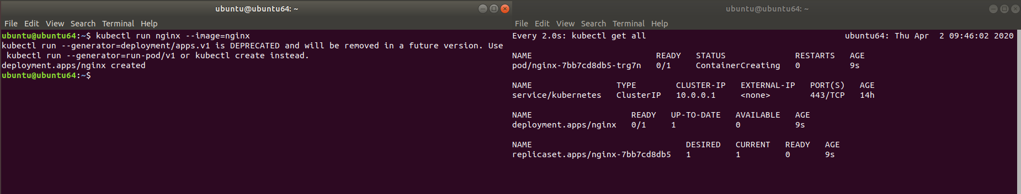
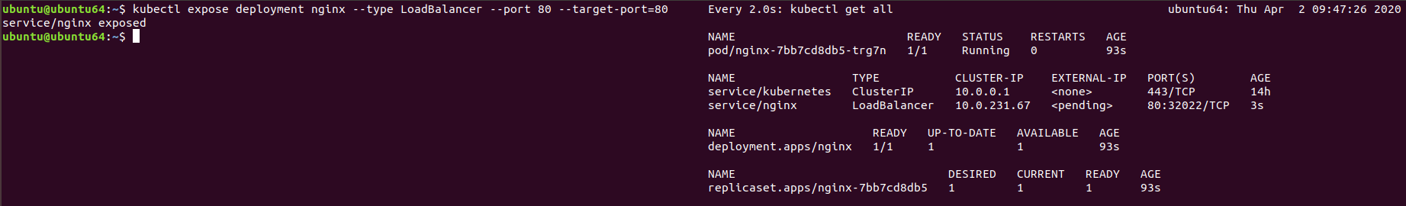
K8S
kubectl run nginx (-> the name of deployment) --image=nginx (this name should be checked)
ubuntu@ubuntu64:~$ kubectl run nginx --image=nginx
kubectl run --generator=deployment/apps.v1 is DEPRECATED and will be removed in a future version. Use kubectl run --generator=run-pod/v1 or kubectl create instead.
deployment.apps/nginx created
ubuntu@ubuntu64:~$

Slide 38
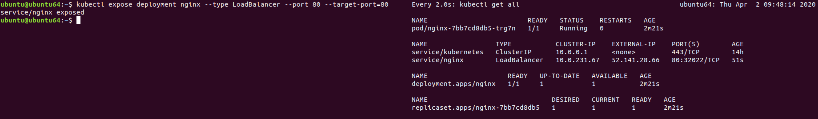
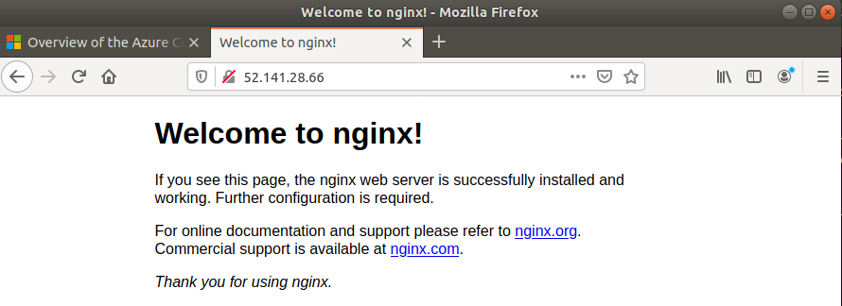
K8S
ubuntu@ubuntu64:~$ kubectl expose deployment nginx --type LoadBalancer --port 80 --target-port=80
service/nginx exposed
ubuntu@ubuntu64:~$
It takes some time to get a public IP address.
Presently, The public IP address is 52.141.28.66

Slide 39
K8S (Delete Command)
ubuntu@ubuntu64:~$ kubectl delete deployment,service nginx
deployment.extensions "nginx" deleted
service "nginx" deleted
ubuntu@ubuntu64:~$

Slide 40
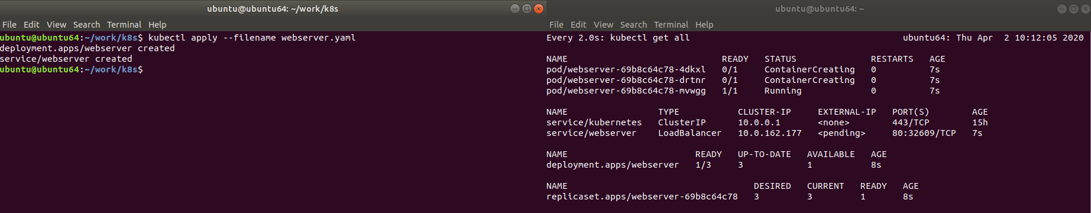
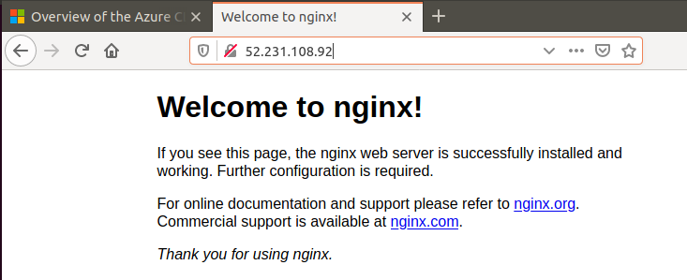
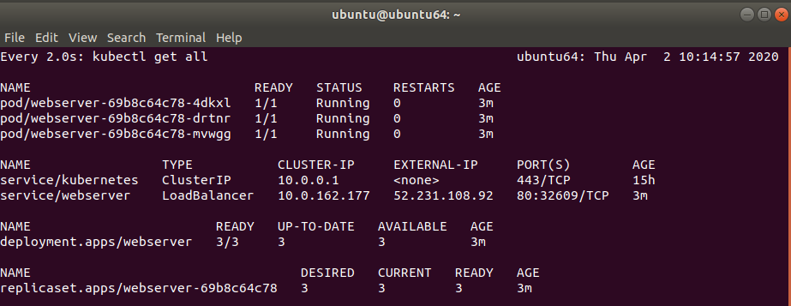
K8S by using yaml file
ubuntu@ubuntu64:~/work/k8s$ kubectl apply --filename webserver.yaml
deployment.apps/webserver created
service/webserver created
ubuntu@ubuntu64:~/work/k8s$

Slide 41
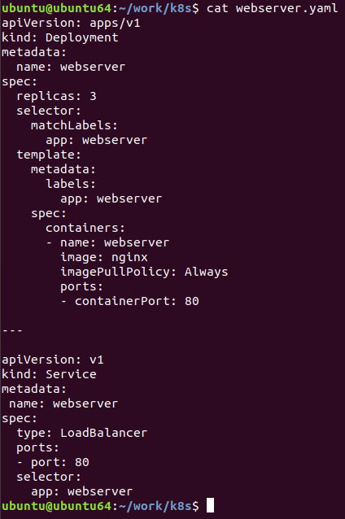
K8S
ubuntu@ubuntu64:~/work/k8s$ cat webserver.yaml
apiVersion: apps/v1
kind: Deployment
metadata:
name: webserver
spec:
replicas: 3
selector:
matchLabels:
app: webserver
template:
metadata:
labels:
app: webserver
spec:
containers:
- name: webserver
image: nginx
imagePullPolicy: Always
ports:
- containerPort: 80
---
apiVersion: v1
kind: Service
metadata:
name: webserver
spec:
type: LoadBalancer
ports:
- port: 80
selector:
app: webserver

Slide 42
K8S
Delete command
ubuntu@ubuntu64:~/work/k8s$ kubectl delete Deployment,Service webserver
deployment.extensions "webserver" deleted
service "webserver" deleted
ubuntu@ubuntu64:~/work/k8s$

Slide 43
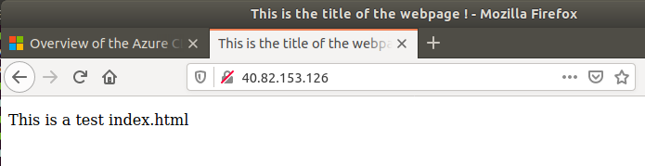
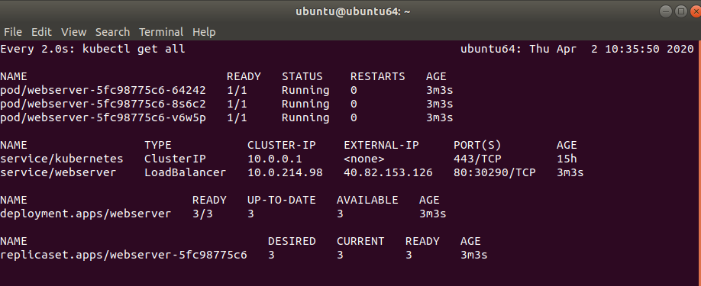
K8S (indentation is very important, --- means a delimiter)
ubuntu@ubuntu64:~/work/k8s$ cat webserver1.yaml
apiVersion: apps/v1
kind: Deployment
metadata:
name: webserver
spec:
replicas: 3
selector:
matchLabels:
app: webserver
template:
metadata:
labels:
app: webserver
spec:
containers:
- name: webserver
image: nginx
imagePullPolicy: Always
ports:
- containerPort: 80
volumeMounts:
- name : html
mountPath: /usr/share/nginx/html
readOnly: true
volumes:
- name : html
gitRepo:
repository: https://github.com/cwlee0220/demo-static.git
revision: master
directory: .
---
apiVersion: v1
kind: Service
metadata:
name: webserver
spec:
type: LoadBalancer
ports:
- port: 80
selector:
app: webserver

Slide 44
K8S
Although you delete pod by using below command, pod will be regenerated automatically by K8S.
# kubectl delete pods –selector app=webserver
You must delete “Deployment” in order to remove pods
# kubectl delete deploy webserver
# kubectl delete service webserver

Slide 45
K8S
1

Slide 46
Azure CI/CD
1

Slide 47
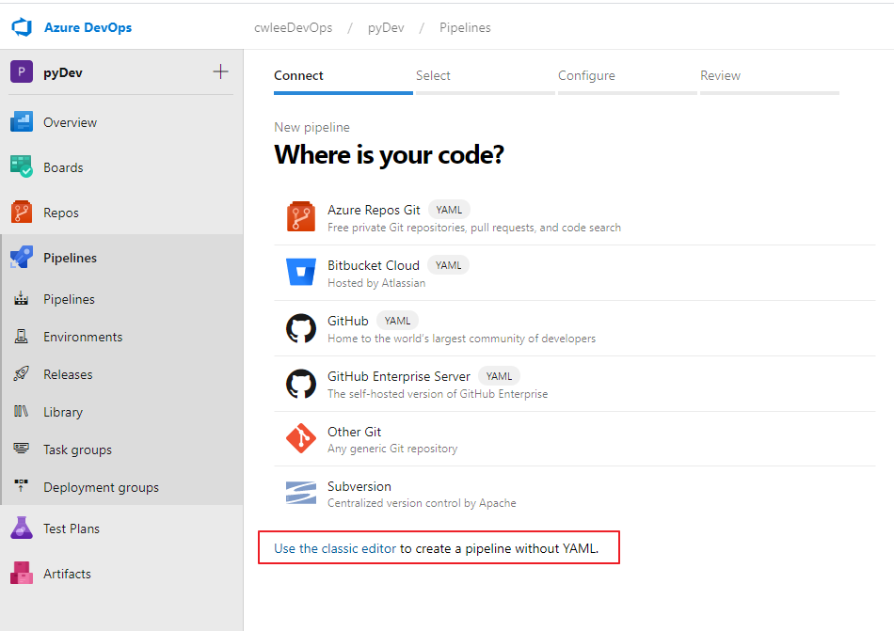
Azure Pipeline
Create Pipeline

Slide 48
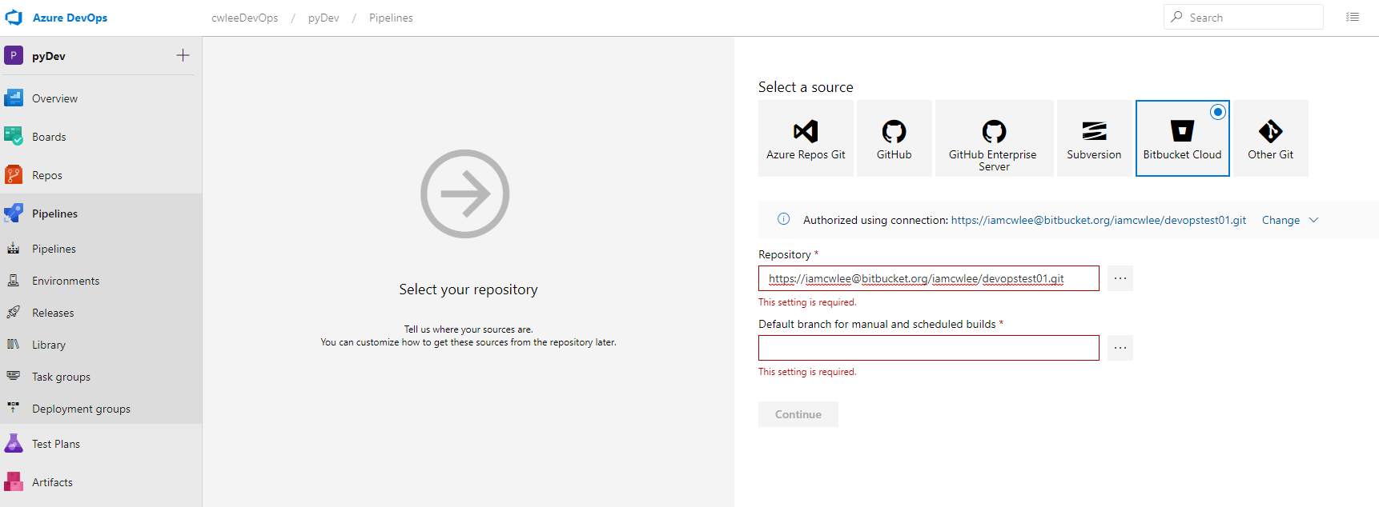
Azure Pipeline
After doing Oauth2 authentication,

Slide 49
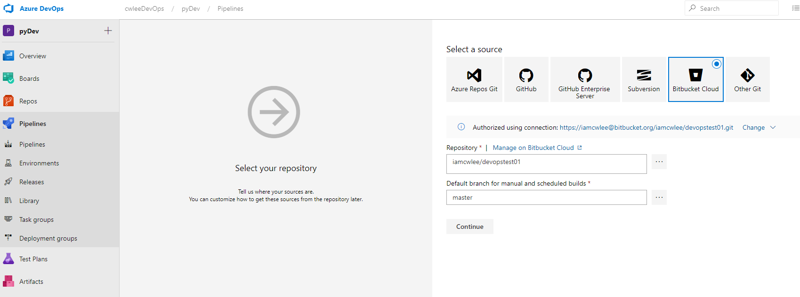
Azure Pipeline
For repository, you must select one of them.

Slide 50
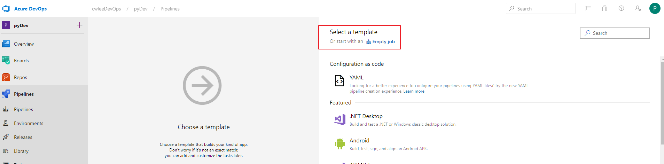
Azure Pipeline
Create Pipeline

Slide 51
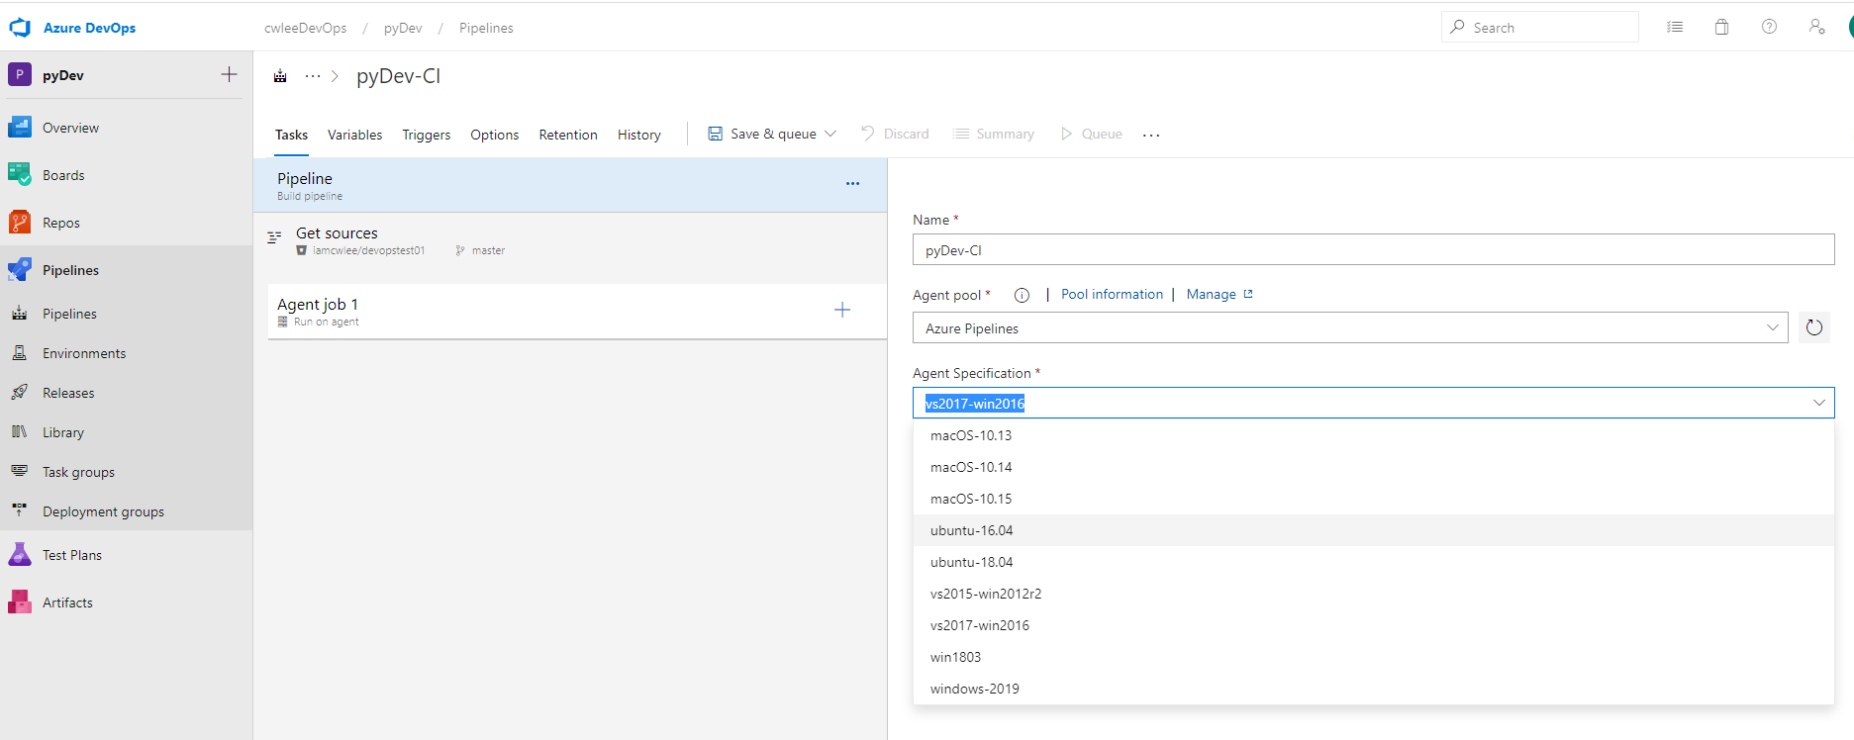
Azure Pipeline
In the test, we will use Ubuntu-16.04 or 18.04 for agent specification.

Slide 52

Azure Pipeline (Adding Agent Jobs)

Slide 53

Azure Pipeline (Adding Agent Jobs)

Slide 54


Azure Pipeline (Agent Job)
Adding bash two times

Slide 55

Azure Pipeline
Bash shell
Installing python packages as below

Slide 56

Azure Pipeline
mkdir ${BUILD_ARTIFACTSTAGINGDIRECTORY}/archive/
git archive --format=tar HEAD | tar -xvf - \
-C ${BUILD_ARTIFACTSTAGINGDIRECTORY}/archive/

Slide 57

Azure Pipeline
Add one more “publish build artifacts”

Slide 58

K8S
1

Slide 59

Python Source Codes &
import platform
from flask import Flask
app = Flask(__name__)
@app.route('/')
def index():
return "I'm in {}".format(platform.node())
if __name__ == '__main__':
app.run(host='0.0.0.0', port=

Slide 60

DevOps (Job in run )
1

Slide 61

DevOps (Job in run )
1

Slide 62

DevOps (Job in run )
1

Slide 63

DevOps (Job in run )
1

Slide 64


CI
1

Slide 65


DevOps (Job in run )
After modifying the file on Bitbucket, CI will be executed automatically.

Slide 66


Docker Hub (Please use public repository)
caprix/devopstest01

Slide 67




CD
1

Slide 68


CD (Docker Registry)
1

Slide 69


CD (AKS Cluster)
1

Slide 70

CD (AKS Cluster - Result)
1

Slide 71

CD
1

Slide 72


CD
1

Slide 73



CD
1

Slide 74


DevOps (Job in run )
1

Slide 75

DevOps (Job in run )
cp -r ${SYSTEM_ARTIFACTSDIRECTORY}/drop/archive/.* .
cp -r ${SYSTEM_ARTIFACTSDIRECTORY}/drop/archive/* .
cat >> .dockerignore <<EOL
drop
EOL

Slide 76

DevOps (Job in run )
1

Slide 77

DevOps (Job in run )
image pods webserver="caprix/devopstest01:${Build.BuildId)" --selector app=webserver

Slide 78



DevOps (Job in run )
1

Slide 79


hub docker
1

Slide 80


CD (Release format)
Release-$(Date:yyyyMMdd)$(Rev:.r)

Slide 81

CD (Enable)
1

Slide 82

CD
1

Slide 83


CD (Pre-approval, Post-approval)
1

Slide 84



CD (Pre-approval, Post-approval)
1

Slide 85
Azure Container RegistryID & Password

Slide 86
ACR
RESOURCE_GROUP=cwleeAKSGroup0
ACR_NAME=cwleeACRms
az group create --name $RESOURCE_GROUP --location japaneast
az acr create --resource-group $RESOURCE_GROUP --name $ACR_NAME --sku Basic
SERVICE_PRINCIPAL_OBJECT_ID="http://acr-${ACR_NAME}-service-principal"
ACR_LOGIN_SERVER=$(az acr show --name $ACR_NAME --query "loginServer" --output tsv)
ACR_RESOURCE_ID=$(az acr show --name $ACR_NAME --query "id" --output tsv)
SP_PASSWORD_FOR_ACR=$(az ad sp create-for-rbac --name $SERVICE_PRINCIPAL_OBJECT_ID --scopes $ACR_RESOURCE_ID --role acrpull --query password --output tsv)
SP_ID_FOR_ACR=$(az ad sp show --id $SERVICE_PRINCIPAL_OBJECT_ID --query appId --output tsv)
echo "Service ID : $SP_ID_FOR_ACR"
echo "Service Password : $SP_PASSWORD_FOR_ACR“

Slide 87

ACR
1

Slide 88

ACR
1

Slide 89
ACR
ubuntu@ubuntu64:~/work/k8s$ ACR_LOGIN_SERVER=$(az acr show --name $ACR_NAME --query "loginServer" --output tsv)
ubuntu@ubuntu64:~/work/k8s$ ACR_RESOURCE_ID=$(az acr show --name $ACR_NAME --query "id" --output tsv)
ubuntu@ubuntu64:~/work/k8s$ SP_PASSWORD_FOR_ACR=$(az ad sp create-for-rbac --name $SERVICE_PRINCIPAL_OBJECT_ID --scopes $ACR_RESOURCE_ID --role acrpull --query password --output tsv)
Creating a role assignment under the scope of "/subscriptions/45fede78-025d-4e91-9f73-a5661023e5b3/resourceGroups/cwleeAKSGroup0/providers/Microsoft.ContainerRegistry/registries/cwleeACRms"
Retrying role assignment creation: 1/36
Retrying role assignment creation: 2/36
Retrying role assignment creation: 3/36
ubuntu@ubuntu64:~/work/k8s$ SP_ID_FOR_ACR=$(az ad sp show --id $SERVICE_PRINCIPAL_OBJECT_ID --query appId --output tsv)
ubuntu@ubuntu64:~/work/k8s$ echo "Service ID : $SP_ID_FOR_ACR"
Service ID : e3c249ca-83e2-474e-bb33-6f512aec9a03
ubuntu@ubuntu64:~/work/k8s$ echo "Service Password : $SP_PASSWORD_FOR_ACR"
Service Password : 5c3c14d0-eb45-4c8a-81e2-2d6d2e320ec6
ubuntu@ubuntu64:~/work/k8s$

Slide 90

ACR
By using the ID and Password, K8S service can pull an image from ACR.

Slide 91

Creating AKS Cluster
[Creating a new cluster]
# az aks create --resource-group cwleeAKSGroup0 --name cwleeAKSCluster01 --service-principal $SP_ID_FOR_ACR --client-secret $SP_PASSWORD_FOR_ACR --generate-ssh-keys

Slide 92
Push Docker image
Docker Hub
# docker build –t id/image:tag
docker login
docker push id/image:tag
ACR
az acr login –name ACRNAME
docker push ACRNAME.azurecr.io/imagename:tag

Slide 93



Adding Service Connection

Slide 94

ACR
Changing Container Registry
Docker hub → ACR

Slide 95

ACR
Retrieving ACR login Server from Azure Portal
cwleeacrms.azurecr.io

Slide 96

ACR
Adding a new K8S cluster

Slide 97

ACR
1

Slide 98

ACR (Before applying ACR)
1

Slide 99

ACR (After applying ACR and new K8S cluster)
Changing Service Connection

Slide 100


Creating
1

Slide 101

ACR
You can check whether the image has been successfully pulled to ACR.

Slide 102
Constructing Pipeline ImageCreator

Slide 103
Creating Resource group and ACR
ubuntu@ubuntu64:~$ RESOURCE_GROUP=solumAKSGroup
ubuntu@ubuntu64:~$ ACR_NAME=solumACRms
ubuntu@ubuntu64:~$ az group create --name $RESOURCE_GROUP --location koreacentral
ubuntu@ubuntu64:~$ az acr create --resource-group $RESOURCE_GROUP --name $ACR_NAME --sku Basic
ubuntu@ubuntu64:~$ SERVICE_PRINCIPAL_OBJECT_ID="http://acr-${ACR_NAME}-service-principal"
ubuntu@ubuntu64:~$ ACR_LOGIN_SERVER=$(az acr show --name $ACR_NAME --query "loginServer" --output tsv)
ubuntu@ubuntu64:~$ ACR_RESOURCE_ID=$(az acr show --name $ACR_NAME --query "id" --output tsv)
ubuntu@ubuntu64:~$ SP_PASSWORD_FOR_ACR=$(az ad sp create-for-rbac --name $SERVICE_PRINCIPAL_OBJECT_ID --scopes $ACR_RESOURCE_ID --role acrpull --query password --output tsv)
ubuntu@ubuntu64:~$ SP_ID_FOR_ACR=$(az ad sp show --id $SERVICE_PRINCIPAL_OBJECT_ID --query appId --output tsv)
ubuntu@ubuntu64:~$ echo "Service ID : $SP_ID_FOR_ACR"
Service ID : 8d4e7294-d7c3-445b-9ab7-8d8e8771bf6a
ubuntu@ubuntu64:~$ echo "Service Password : $SP_PASSWORD_FOR_ACR"
Service Password : 61b3fa7d-ce91-4113-84d5-d0050a626ed3
By using the ID and Password, K8S service can pull an image from ACR.

Slide 104

Screen Capture - 1

Slide 105

Screen Capture - 2

Slide 106

Screen Capture - 3

Slide 107

Creating AKS Cluster
[Creating a new cluster]
# az aks create --resource-group solumAKSGroup --name solumAKSCluster --service-principal $SP_ID_FOR_ACR --client-secret $SP_PASSWORD_FOR_ACR --generate-ssh-keys

Slide 108

Pipeline - ImageCreator
111

Slide 109

Pipeline - ImageCreator
We are using bitbucket. So, please select bitbucket Cloud.

Slide 110

Pipeline - ImageCreator
Empty Job

Slide 111

Pipeline - ImageCreator
Changing the name of Pipeline (cloudesl-ImageCreator)
Changing Agent Specification (Ubunbu-18.04)

Slide 112





Pipeline - ImageCreator
Add tasks ( three tasks )
maven , bash , publish build artifacts

Slide 113

Pipeline - ImageCreator
For Maven task, there is no modification.
For Bash Script, please modify the task as below.
mkdir ${BUILD_ARTIFACTSTAGINGDIRECTORY}/archive/
mkdir ${BUILD_ARTIFACTSTAGINGDIRECTORY}/archive/target/
cp Dockerfile ${BUILD_ARTIFACTSTAGINGDIRECTORY}/archive/
cp ./target/*-spring-boot.jar ${BUILD_ARTIFACTSTAGINGDIRECTORY}/archive/target/imggenerator.jar

Slide 114

Pipeline - ImageCreator
We have to copy the files to a specific folder (In this example, archive)
After executing this task, a new artifact can be released by using the third task.

Slide 115


Pipeline - ImageCreator
Run the pipeline

Slide 116

Pipeline - ImageCreator
Before building the source code, the files from bitbucket will be copied to the specific folder which is managed by the machine.
https://docs.microsoft.com/en-us/azure/devops/pipelines/build/variables?view=azure-devops&tabs=yaml

Slide 117

Pipeline - ImageCreator
We have to copy the jar file to the specific folder (archive)

Slide 118

Pipeline - ImageCreator
By using the bash script, two files (Dockerfile & *.jar) can be copied to the artifact

Slide 119

Pipeline - ImageCreator
We have successfully done the pipeline tasks.

Slide 120

Pipeline - ImageCreator
Please check the below option to enable or disable the pipeline.

Slide 121

Release - ImageCreator
Releases → New Release pipeline

Slide 122

Release - ImageCreator
Empty job

Slide 123

Release - ImageCreator
Add an artifact
Source Alias → drop (this will be used later)

Slide 124

Release - ImageCreator
Agent Job → Agent Specification (ubuntu-18.04)

Slide 125


Release - ImageCreator
Add two tasks (bash & docker)

Slide 126

Release - ImageCreator
Bash Script ( Source Alias “drop” is used in the below folder structure)
cp -r ${SYSTEM_ARTIFACTSDIRECTORY}/drop/archive/.* .
cp -r ${SYSTEM_ARTIFACTSDIRECTORY}/drop/archive/* .
cat >> .dockerignore <<EOL
drop
EOL

Slide 127

Release - ImageCreator
Container Registry & Container Repository

Slide 128

Release - ImageCreator
Release-$(rev:r) →
Release-$(Date:yyyyMMdd)$(Rev:.r)

Slide 129

Release - ImageCreator
After saving the status, create release

Slide 130


Release - ImageCreator
[Result] After creating release, you can check whether a new docker image has been successfully created on ACR.

Slide 131

Release - ImageCreator
How to use Continuous deployment trigger.

Slide 132
Constructing Pipeline Inbound
Please check how to create pipeline and release of ImageCreator first.
For inbound, some steps are omitted due to duplication

Slide 133

Pipeline - inbound
Update Agent details (ubuntu – 18.04)

Slide 134

Pipeline - inbound
Add Gradle build cache

Slide 135

Pipeline - inbound
java -version
echo $(GRADLE_USER_HOME)
echo $(Agent.OS)
chmod +x ./gradlew
./gradlew --build-cache clean build
# stop the Gradle daemon to ensure no files are left open (impacting the save cache operation later)
./gradlew --stop

Slide 136

Pipeline - inbound
If we want to specify a JDK Version to be used to build Java source (JDK 8)
We must add below env variables.
JAVA_HOME: $(JAVA_HOME_8_X64)
PATH: $(JAVA_HOME_8_X64)/bin:$(PATH)

Slide 137

Pipeline - inbound
mkdir ${BUILD_ARTIFACTSTAGINGDIRECTORY}/archive/
mkdir -p ${BUILD_ARTIFACTSTAGINGDIRECTORY}/archive/build/libs/
mkdir -p ${BUILD_ARTIFACTSTAGINGDIRECTORY}/archive/AIMS/env/
cp Dockerfile ${BUILD_ARTIFACTSTAGINGDIRECTORY}/archive/
ls -al
ls ./build/libs/ -al
cp ./build/libs/*.jar ${BUILD_ARTIFACTSTAGINGDIRECTORY}/archive/build/libs/

Slide 138

Pipeline - inbound
Add Bash script and publish build artifact

Slide 139

Release - inbound
cp -r ${SYSTEM_ARTIFACTSDIRECTORY}/drop/archive/.* .
cp -r ${SYSTEM_ARTIFACTSDIRECTORY}/drop/archive/* .
cat >> .dockerignore <<EOL
drop
EOL

Slide 140

Release - inbound
Add Bash script and publish build artifact

Slide 141

Release - inbound
Result

Slide 142

Release - inbound
On ACR dashboard, you can check that a new docker image has been successfully created as below

Slide 143
Constructing Pipeline Outbound
Please check how to create pipeline and release of ImageCreator first.
For inbound, some steps are omitted due to duplication

Slide 144

Pipeline - outbound
Add Bash script and publish build artifact

Slide 145

Pipeline - outbound
Bash Script
mkdir ${BUILD_ARTIFACTSTAGINGDIRECTORY}/archive/
mkdir -p ${BUILD_ARTIFACTSTAGINGDIRECTORY}/archive/build/libs/
mkdir -p ${BUILD_ARTIFACTSTAGINGDIRECTORY}/archive/AIMS/env/
cp Dockerfile ${BUILD_ARTIFACTSTAGINGDIRECTORY}/archive/
cp ./build/libs/*.jar ${BUILD_ARTIFACTSTAGINGDIRECTORY}/archive/build/libs/
cp ./AIMS/env/aims.properties ${BUILD_ARTIFACTSTAGINGDIRECTORY}/archive/AIMS/env/

Slide 146

Pipeline - outbound
publish build artifact

Slide 147

Release - outbound
Add Bash script and publish build artifact

Slide 148

Release - outbound

Slide 149


Release - outbound
cp -r ${SYSTEM_ARTIFACTSDIRECTORY}/drop/archive/.* .
cp -r ${SYSTEM_ARTIFACTSDIRECTORY}/drop/archive/* .
cat >> .dockerignore <<EOL
drop
EOL

Slide 150

Release - outbound

Slide 151
Constructing Pipeline API Service
Please check how to create pipeline and release of ImageCreator first.
For inbound, some steps are omitted due to duplication

Slide 152

Pipeline - apiservice

Slide 153

Pipeline - apiservice
Add Bash script and publish build artifact

Slide 154

Pipeline - apiservice
mkdir ${BUILD_ARTIFACTSTAGINGDIRECTORY}/archive/
mkdir -p ${BUILD_ARTIFACTSTAGINGDIRECTORY}/archive/dist/
cp Dockerfile ${BUILD_ARTIFACTSTAGINGDIRECTORY}/archive/
cp -r ./dist/* ${BUILD_ARTIFACTSTAGINGDIRECTORY}/archive/dist/

Slide 155

Pipeline - apiservice

Slide 156

Release - apiservice
cp -r ${SYSTEM_ARTIFACTSDIRECTORY}/drop/archive/.* .
cp -r ${SYSTEM_ARTIFACTSDIRECTORY}/drop/archive/* .
cat >> .dockerignore <<EOL
drop
EOL

Slide 157

Release - apiservice
Add Bash script and publish build artifact

Slide 158
Constructing Pipeline image-creator without building the source codes
Please check how to create pipeline and release of ImageCreator first.
For inbound, some steps are omitted due to duplication

Slide 159

Pipeline - imagecreator
mkdir ${BUILD_ARTIFACTSTAGINGDIRECTORY}/archive/
mkdir -p ${BUILD_ARTIFACTSTAGINGDIRECTORY}/archive/target/
cp Dockerfile ${BUILD_ARTIFACTSTAGINGDIRECTORY}/archive/
cp -r ./target/* ${BUILD_ARTIFACTSTAGINGDIRECTORY}/archive/target/

Slide 160

Pipeline - imagecreator
Add Bash script and publish build artifact

Slide 161

Release - imagecreator

Slide 162

Release - imagecreator
Add Bash script and publish build artifact

Slide 163

Release - imagecreator
cp -r ${SYSTEM_ARTIFACTSDIRECTORY}/drop/archive/.* .
cp -r ${SYSTEM_ARTIFACTSDIRECTORY}/drop/archive/* .
cat >> .dockerignore <<EOL
drop
EOL

Slide 164

Pipeline - imagecreator
Add Bash script and publish build artifact

Slide 165
How to use kubernetes with our microservices
In this example, we will use AKS Cluster we have made.

Slide 166

How to manage multiple clusters in AKS
https://zimmergren.net/switch-context-multiple-kubernetes-clusters-aks-azure/
# az login
[List]
# az aks list -o table
[Connect to an AKS cluster using the Azure CLI]
# az aks get-credentials -n <yourClusterName> -g <yourResourceGroupName>
# az aks get-credentials -n solumAKSCluster -g solumAKSGroup

Slide 167


How to switch cluster
Using kubectl config get-contexts we'll be able to see all the clusters we've authenticated against, regardless what subscription they're in:
[Switch Cluster] # kubectl config use-context <yourClusterName>

Slide 168

How to check the cluster information in the list
# kubectl config view

Slide 169


cluster-info
# kubectl cluster-info
# kubectl get node
# kubectl get node -o=wide

Slide 170


How to get information of a specific node
# kubectl get node
# kubectl describe node aks-nodepool1-19025009-vmss000000

Slide 171

YAML Template from github
https://github.com/ToruMakabe/Understanding-K8s

Slide 172

Checking the status of pods and nodes periodically
You can check the status K8S periodically by using linux watch command as below
watch kubectl get all
watch kubectl get pods
watch kubectl get nodes
kubectl get nodes -o wide

Slide 173



Managing the number of nodes
# az aks scale --resource-group myResourceGroup --name myAKSCluster --node-count 3
# az aks scale -n solumAKSCluster -g solumAKSGroup --node-count 1

Slide 174

How to update the docker image on AKS cluster
By using a additional task, Docker image can be updated automatically.
image pods apiservice=solumacrms.azurecr.io/apiservice_img:$(Build.BuildId) --selector app=apiservice

Slide 175

What is the parameter $(Build.BuildId) ?
When creating a new release, you can check the parameter.
You can manually update the application
# kubectl set image pods apiservice=solumacrms.azurecr.io/apiservice_img:48 --selector app=apiservice
https://docs.microsoft.com/en-us/azure/aks/tutorial-kubernetes-app-update
# kubectl set image deployment azure-vote-front azure-vote-front=<acrLoginServer>/azure-vote-front:v2

Slide 176

How to check the status of all
# watch kubectl get all

Slide 177

How to configure Public IP Address
https://docs.microsoft.com/en-us/azure/aks/egress

Slide 178

How to configure Public IP Address - Test
# az aks show --resource-group solumAKSGroup --name solumAKSCluster --query nodeResourceGroup -o tsv
MC_solumAKSGroup_solumAKSCluster_koreacentral
# az network public-ip create \
--resource-group MC_solumAKSGroup_solumAKSCluster_koreacentral \
--name solumAKSPublicIP \
--allocation-method static
52.231.91.148

Slide 179

How to delete Public IP Address - Test
https://docs.microsoft.com/en-us/cli/azure/network/public-ip?view=azure-cli-latest#az-network-public-ip-delete
az network public-ip delete -g MC_solumAKSGroup_solumAKSCluster_koreacentral -n solumAKSPublicIP

Slide 180


Test (Public IP - egress)
https://docs.microsoft.com/en-us/azure/aks/egress
# kubectl run -it --rm aks-ip --image=debian --generator=run-pod/v1
# when executing the egress service, it doesn’t work.

Slide 181

outbound public IP
# az network public-ip list -g MC_solumAKSGroup_solumAKSCluster_koreacentral
In this case,
egress configuration is not needed.

Slide 182

The screenshot when executing all services
All services are running on the same cluster (AKS)

Slide 183

Useful commands for K8S
https://kubernetes.io/docs/reference/kubectl/cheatsheet/

Slide 184



How to “Live Tail” Kubernetes Logs
https://blog.papertrailapp.com/how-to-live-tail-kubernetes-logs/
In this example, the pod name of inbound is as below.
inbound-deployment-67bc5b44ff-s9t54
# kubectl logs --follow inbound-deployment-67bc5b44ff-s9t54

Slide 185



How to debug multiple microservices
https://github.com/johanhaleby/kubetail
http://code.haleby.se/2015/11/13/tail-logs-from-multiple-pods-simultaneously-in-kubernetes/
https://ckhconsulting.com/kubetail-watch-multiple-pod-logs-the-easy-way/
kubetail is a bash script for debugging multiple pods

Slide 186
How to start our microservices on AKS cluster
# kubectl apply -f apiservice.yaml
# kubectl apply -f imggenerator.yaml
# kubectl apply -f inbound.yaml
# kubectl apply -f outbound.yaml
# kubectl apply -f service-apiservice.yaml

Slide 187
How to setup a VM for monitoring AKS

Slide 188

VM to monitor AKS Cluster for all members
We will use the below VM for monitoring AKS cluster.
Please add your IP address in the below inbound rules.

Slide 189


How to install az
https://docs.microsoft.com/en-us/cli/azure/install-azure-cli-apt?view=azure-cli-latest
# curl -sL https://aka.ms/InstallAzureCLIDeb | sudo bash

Slide 190


How to log in
https://docs.microsoft.com/en-us/cli/azure/authenticate-azure-cli?view=azure-cli-latest

Slide 191

How to install docker
# sudo apt-get install docker.io
# sudo usermod -a -G docker $USER
# sudo service docker restart
Rebooting ( log out and log in again)

Slide 192

How to install kubectl
https://phoenixnap.com/kb/install-kubernetes-on-ubuntu
curl -s https://packages.cloud.google.com/apt/doc/apt-key.gpg | sudo apt-key add
sudo apt-get install curl
sudo apt-add-repository "deb http://apt.kubernetes.io/ kubernetes-xenial main"
sudo apt-get install kubeadm kubelet kubectl
sudo apt-mark hold kubeadm kubelet kubectl

Slide 193
How to install kubectl
https://phoenixnap.com/kb/install-kubernetes-on-ubuntu
curl -s https://packages.cloud.google.com/apt/doc/apt-key.gpg | sudo apt-key add
sudo apt-get install curl
sudo apt-add-repository "deb http://apt.kubernetes.io/ kubernetes-xenial main"
sudo apt-get install kubeadm kubelet kubectl
sudo apt-mark hold kubeadm kubelet kubectl

Slide 194

How to manage multiple clusters in AKS
https://zimmergren.net/switch-context-multiple-kubernetes-clusters-aks-azure/
# az login
[List]
# az aks list -o table
[Connect to an AKS cluster using the Azure CLI]
# az aks get-credentials -n <yourClusterName> -g <yourResourceGroupName>
# az aks get-credentials -n solumAKSCluster -g solumAKSGroup

Slide 195

where is information for connecting to my kubernetes ?
# cat ~/.kube/config

Slide 196
How to execute and debug each microservice

Slide 197
How to start and stop each microsevice
[Starting each microservice]
# kubectl apply -f apiservice.yaml
# kubectl apply -f imggenerator.yaml
# kubectl apply -f inbound.yaml
# kubectl apply -f outbound.yaml
[Stopping each microservice]
# kubectl delete -f apiservice.yaml
# kubectl delete -f imggenerator.yaml
# kubectl delete -f inbound.yaml
# kubectl delete -f outbound.yaml

Slide 198


How to check logs of each microsevice
Please check the name of pods
# kubectl get pods
In order to check logs of multiple pods with different colors, we will use a useful script (kubetail)
Please move to the specific folder
# ./kubetail apiservice-deployment

Slide 199

How to check logs of each microsevice
In order to call REST API on apiservice, we have to enable loadbalancer service for apiservice.
please execute the below command
It takes long time to get public IP to connect to apiservice.
# kubectl apply -f service-apiservice.yaml
The public IP can be changed. So please check it before calling REST API on apiservice.
To check the status of AKS every 2 secs
# watch kubectl get all

Slide 200


How to update the container image of each microservice
# kubectl set image pods apiservice=solumacrms.azurecr.io/apiservice_img:48 --selector app=apiservice

Slide 201

How to update the container image of each microservice
# kubectl set image pods apiservice=solumacrms.azurecr.io/apiservice_img:48 --selector app=apiservice
Updating the container image of each microsevice, you can check that pods are restarted as below

Slide 202
How to use label information (--show-labels)
# kubectl get pods --show-labels

Slide 203

How to check the status of pod
# kubectl describe pods inbound

Slide 204


How to check the status of node
# kubectl get nodes
# kubectl describe node aks-nodepool1-19025009-vmss000000

Slide 205

Namespace (Resource separation)
By using namespace, we can separate projects in a cluster.
Later, we can use this...
Nodes are shared by all projects ??? (Is it good ?)

Slide 206


How to check CPU and memory usage of each pod
# kubectl top pod
# kubectl top node
or
# watch kubectl top pod
# watch kubectl top node

Slide 207
How to use Application Gateway

Slide 208

How
https://github.com/Azure/application-gateway-kubernetes-ingress
https://atouati.com/posts/2020/03/aks-application-gateway-ingress-controller/
https://zerobig-k8s.tistory.com/72?category=297761
https://zerobig-k8s.tistory.com/74?category=297761
https://atouati.com/posts/2020/03/aks-application-gateway-ingress-controller/
https://github.com/Adeelku/aks-agic/blob/master/scripts/deploy_into_k8s.sh
https://github.com/kizotheitguy/Azure-AKS-ApplicationGateway-WAF

Slide 209
How
11

Slide 210
How
11

Slide 211
How
11

Slide 212
How
11

Slide 213
How
11

Slide 214
How
11

Slide 215
How
11

Slide 216
How
11

Slide 217
How
11

Slide 218

THANK YOU

